Slide 1
18-349: Introduction to Embedded Real-Time Systems
Lecture 17: Low-Power Embedded
Anthony Rowe
Electrical and Computer Engineering
Carnegie Mellon University

Slide 2
Administrivia
Lab 3 rolling along

Slide 3
Overview
Why do we care about power?
Low-Power Scheduling
Dynamic Voltage and Frequency Scaling
Rate Harmonized Scheduling
Energy-Saving RHS
Timer Coalescing

Slide 4



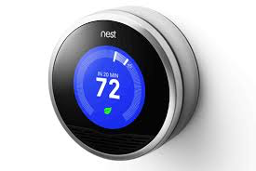
Why do we care about power?

Slide 5







Power Trend in Mobile Devices
Power Demand
Mobile
Multimedia
Higher Bandwidth
Higher Computing
Power
Multimedia
Message/
Broadband Internet
Picture Message/
Narrowband Internet
Voice/Text/
SMS
Power Supply
(Energy Density)
1990
From phone to computing platforms
2010
year
The power supply & demand relationship is according to unpublished research by the Boston Consulting Group
Notes:
"According to unpublished research by the Boston Consulting Group, the amount of energy that a battery can store (its energy density) is growing by 8% a year. Mobile-device power consumption, meanwhile, is growing at more than three times this rate, as backlit colour screens, high-speed wireless networks and more powerful microprocessors draw ever-larger amounts of power."

Slide 6
Important Note
The peak computing rate needed is much higher than the average throughput that must be sustained;
High performance is needed only for a small fraction of time, while for the rest of time, a low-performance, a low-power processor would suffice.

Slide 7
Workload Profile
Peak Computing Rate is needed
Work load
Average rate would suffice
Time

Slide 8
Motivations
The power consumption of CMOS circuits is given by P α C_{L} * V²_{dd} * f
f α (V_{dd}-V_{th})^{α} / V_{dd} ; For a 0.25-m technology, α ≈ 1.3-1.5
Energy = P * Delay ≈ k * f ^{2/(α-1)} ≈ k * f ^{x}
Running a CPU at lower speed consumes less energy
Real-Time Tasks are required to complete at their deadline.
Reducing the CPU speed to complete the task just before its deadline achieves the same performance but saves energy

Slide 9
Issue of Operating Voltage/Frequency
Predominant device technology is CMOS
In CMOS, slower (faster) frequency means lower (higher) number of transitions
Hence, lower power is consumed
Power is proportional to V²f
P → Power
V → Voltage
f → Frequency
Can reduce unit computation energy by reducing frequency and voltage
Maximum gate delays inversely related to voltage
Applies to processors.
Can be applied to memory as well.
Check specifications carefully.

Slide 10
Scaling Techniques
DFS: Dynamic Frequency Scaling
Lower or increase clock frequency
With lower frequency, the same amount of work (# of instructions to be executed) takes longer
Hence, power may go down, but energy may remain the same
DVS: Dynamic Voltage Scaling
Lower or increase clock voltage
As frequency increases, higher voltage is required
Conversely, as frequency is lowered, only a lower voltage is required
DVFS: Dynamic Voltage/Frequency Scaling
Scale voltage up (down) when frequency is scaled up (down)
Needs processors supporting software adjustable PLL, voltage regulator
e.g., XScale, SpeedStep, PowerNow!, Crusoe, many many more…

Slide 11
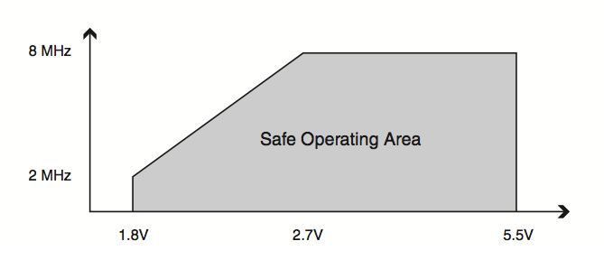
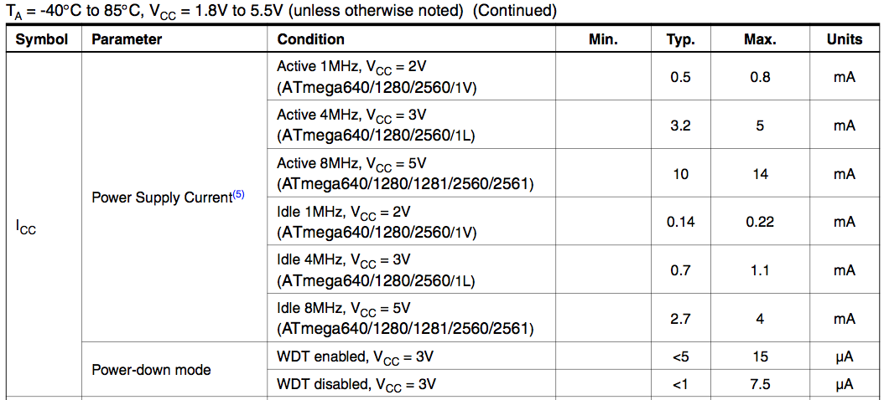
DVFS Example
Atmel ATmega1281

Slide 12
DVS-example
Consider a task with a computation time 20 units.
Energy of T_{i} without DVS:
E1 = K * 20 * F^{2.}
Energy of T_{i} with DVS:
E2 = K * 20 * (F/2)^{2.}
We see that E2 = (E1)/4
Time taken = t1 (say)
Time taken = t2 = 2 * t1
Therefore, if we reduce the frequency we save energy but, we spend more time in performing the same computation

Slide 13
Using DFS
“Static” DFS
Taskset: t₁= (1, 5) t₂ ₌ (2, 10) t₃ = (1, 10)
U = 1/5 + 2/10 + 1/10 = 0.5
τ₁
τ₂
τ₃
τ₁
τ₁
τ₂
τ₃
τ₁
10
15
Before DFS
0
5
10
15
20
After DFS
τ₁
τ₂
τ₁
τ₂
τ₃
τ₁
τ₂
τ₁
τ₂
τ₃
15
0
5
10
15
20

Slide 14
Simple DVS scheme handling RT-task
No DVS
Frequency
F
20@F
20
30
time
Inference:
DVS cannot be blindly applied to real-time embedded systems
DVS: Low workload
Frequency
F
F/2
20@(F/2)
20
40
time

Slide 15
Overview
Why do we care about power?
Low-Power Scheduling
Dynamic Voltage and Frequency Scaling
Rate Harmonized Scheduling
Energy-Saving RHS
Timer Coalescing

Slide 16

Aside: Computing Battery Life
Batteries specified in Amp-Hours (AH) or milli Amp-Hour (mAH)
Not really a measure of energy!
1AH (or 1000mA) means that the battery can provide 1 Amp of current for an hour or 1mA of current for 1000 hours at the nominal voltage
How do we use it?
Compute your average current consumption i_{a}
Take battery capacity in AH and divide by i_{a}
This gives you total expected hours
Capacity is temperature and load dependent
AA is typically 2800mAH capacity

Slide 17
Processor Energy States
1ms
6uS
Sleep
5uW
Idle
6mW
Active
30mW
10ms
6uS

Slide 18
Power Modes of Microcontrollers
Power state | Power (mW) | Upward Transition Time
Active | 30 mW | n/a
Idle | 6 mW | 6 us
Sleep | 5 uW | 10 ms
Power Management: maximize the Sleep-time of processors
given {Sleep, Idle, Active} modes of operation

Slide 19
Simple RMS Example
0
5
10
15
20
25
30
35
40
45
50
55
60
65
70
75
80
85
90
95
100
105
110
{ c, t }
τ₁
{5,35}
{5,50}
τ₂
Idle
Sleep
C_{sleep} = 15

Slide 20
Example CPU parameters
Processor | Freq. (MHz) | Power Sleep (mW) | Power Idle (mW) | Power Active (mW) | Sleep to Idle (ms) | Idle to Active (us)
ATmega1281 | 8 | .016 | 6.6 | 23 | 12 | 6
Hitachi H8 | 8 | .00005 | 60 | 90 | 100 | 8
MSP430F5418 | 8 | 0.00033 | 0.0085 | 4 | 10 | 5
ST Cortex M3 | 20 | .0056 | 18.5 | 85 | 2 | 2
LPC2106 | 60 | .001 | 10 | 108 | 10 | 4
BF531 | 600 | .015 | 30 | 616 | 5 | 2

Slide 21
RHS Problem Statement
Modern processors have support for different sleep modes
Active (Most energy, full processing)
Idle (Low energy, but no processing)
Sleep (Lowest energy, oscillator off)
These states have a transition time penalty
Active <-> Idle (fast)
Idle <-> Sleep (slow due to oscillator spin-up)
Sometimes we can’t sleep because the transition time would be too long
Can we batch task execution together to reduce transition overhead?

Slide 22
Rate-Harmonizing Schedulers
Use a Harmonizing Base Period denoting when tasks are eligible to execute
Tasks released as they normally would be released (only eligible after base period)
Cluster task execution together whenever possible
Maintain analyzable utilization bounds

Slide 23
0
5
10
15
20
25
30
35
40
45
50
55
60
65
70
75
80
85
90
95
100
105
110
τ₁
{1,10}
τ₂
{1,15}
τ₃
{2,26}
Idle
Sleep
RMS (C_{sleep} =5)
τ₁
{1,10}
τ₂
{1,15}
τ₃
{2,26}
Idle
Sleep
RHS (C_{sleep} =5)
Base Harmonizing Period = 10

Slide 24
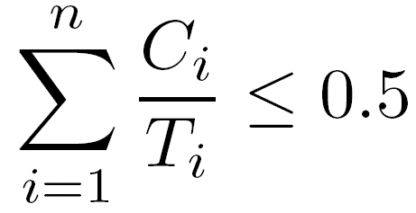

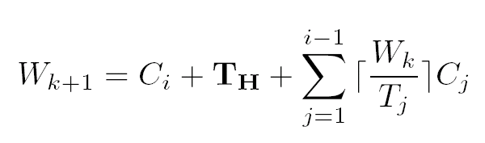
What about the schedulability (RHS)?
Task sets are still feasible under basic rate harmonized scheduling if:
Exact schedulability condition:

Slide 25
All idles appear to be gone…
0
0
5
5
10
10
15
15
20
20
25
25
30
30
35
35
40
40
45
45
50
50
55
55
60
60
65
65
70
70
75
75
80
80
85
85
90
90
95
95
100
100
105
105
110
110
τ₁
τ₁
{1,10}
{1,10}
τ₂
{1,15}
τ₂
{1,15}
τ₃
{2,26}
τ₃
{2,26}
Idle
Idle
Sleep
Sleep
RHS (C_{sleep} =7)
RHS (C_{sleep} =5)
Base Harmonizing Period = 10
No, identical task set with C_{sleep} = 7

Slide 26
Energy-Saving Rate-Harmonizing Scheduling
Create an Energy Saver task with
period = rate-harmonizing period
budget = sleep time required for the rate-harmonizing task

Slide 27
Energy Saving RHS
0
5
10
15
20
25
30
35
40
45
50
55
60
65
70
75
80
85
90
95
100
105
110
τ₁
{1,10}
τ₂
{1,15}
τ₃
{2,26}
Idle
Sleep
RHS (C_{sleep} =7)
τ₁
{1,10}
τ₂
{1,15}
τ₃
{2,26}
Idle
Sleep
Energy Saver Task
Energy-Saving RHS (C_{sleep} =7)
Slack is merged together

Slide 28
Properties of Energy Saving RHS
All Idle task slots become sleep!
We might not need all three CPU states
Energy Consumption is now very regular
We can more accurately estimate lifetimes

Slide 29
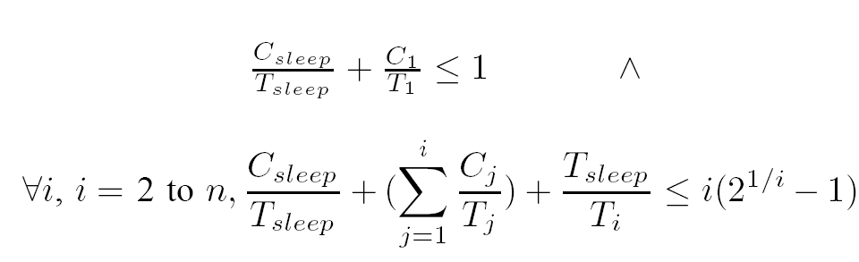
What about schedulability (ES-RHS)?
Only exact case condition

Slide 30
How much energy can we save?
Task | C | T | U
1 | 1 | 20 | .050
2 | 1 | 25 | .040
3 | 1 | 26 | .038
4 | 1 | 28 | .035
5 | 1 | 32 | .031
6 | 2 | 50 | .04
7 | 2 | 67 | .029
8 | 3 | 91 | .033
9 | 9 | 100 | .090
C_{sleep} = 10 ms
T_{sleep} = 20 ms
CPU = ATmega1281
RMS = 9.83 mW
ES-RHS = 6.5 mW
RHS saves 33%

Slide 31
How much do we save in a real system?
Task | C | T | U
Link Layer | 1 | 20 | .050
Network Layer | 1 | 25 | .040
HF Sensor Sampling | 1 | 26 | .038
Mobile Node Service | 1 | 28 | .035
Diagnostic | 1 | 32 | .031
RMS = 2.38mW RHS = 2.00 mW
During the most active states we see a 16% savings on CPU energy

Slide 32
Summary
Why do we care about power?
Low-Power Scheduling
Dynamic Voltage and Frequency Scaling
Rate Harmonized Scheduling
Energy-Saving RHS
Timer Coalescing
Up Next: RT communication

